Slide 1

SENTIMENT ANALYSIS
OF
TWITTER
(Logistic Regression Based)

Slide 2
TABLE OF CONTENTS
1
Overview
2
Authors
3
Algorithm&Packages(R&Python)
4
Python code
5
R-Code
6
Weka
7
Resources

Slide 3
OVERVIEW
To train a logistic Regression model that classifies the sentiment tweets as positive or negative in Python, R and WEKA

Slide 4
AUTHORS
Abdullah Mohamed Elgondakly
Kareem Adel
Ragab
2305388
2305381

Slide 5

The Algorithm
(Logistic Regression)
  Binary output & probabilities. Naturally, it models “positive vs. negative” and gives a probability score.
  Interpretable coefficients
Each βₖ tells you how much feature xₖ shifts the log-odds of positivity.
  Efficient & scalable
Fast training/inference on high-dimensional text features (TF–IDF, n-grams).

Slide 6
Used Libraries (Python)
  Pandas : Data Loading & Manipulation
  Streamlit: Interactive Web App Library
  Matplotlib :Used in Python to generate clear, publication-quality visualizations—such as bar charts of sentiment counts
  Seaborn: for data visualization
  regex: Enables pattern-based text cleaning—quickly strip out URLs, mentions, hashtags, and unwanted characters to prepare tweets for feature extraction.
  Sklearn: Provides the LogisticRegression estimator and tools like Pipeline, TfidfVectorizer, and train_test_split
  wordcloud: Visualizing word frequencies as a cloud of words

Slide 7
Used Libraries (R)
  tidyverse : Data manipulation(dplyr,ggplot)
  caret: Model Training and evaluation
  glmnet: Fits elastic-net regularized logistic regression on your cleaned text features to detect sentiment, balancing L1/L2 penalties for feature selection and preventing overfitting.
  Matrix: Sparse Matrix handling

Slide 8

  PYTHON

Slide 9
Python-Load data
def load_data():
df = pd.read_csv("C:/Users/abdul/Downloads/training.1600000.processed.noemoticon.csv",
encoding='latin-1',
names=['target', 'id', 'date', 'flag', 'user', 'text'])
df = df[['target', 'text']]
df = df.sample(10000, random_state=42)
return df
Explaination:Reads the Sentiment140 dataset, selects relevant columns (target and text), and samples 10,000 tweets to reduce computation time.

Slide 10
Python-clean Text
def clean_text(text):
text = re.sub(r"http\S+", "", text)
text = re.sub(r"@\w+", "", text)
text = re.sub(r"#\w+", "", text)
text = re.sub(r"[^\w\s]", "", text)
text = text.lower()
return text
Explanation:Cleans the tweets by removing URLs, mentions, hashtags, punctuation, and converting text to lowercase for normalization.

Slide 11
python-wordCloud Plot
def plot_wordcloud(texts, title):
all_words = ' '.join(texts)
wc = WordCloud(width=800, height=400, background_color='white', colormap='viridis').generate(all_words)
fig, ax = plt.subplots(figsize=(10, 5))
ax.imshow(wc, interpolation='bilinear')
ax.axis('off')
st.subheader(title)
st.pyplot(fig)
plt.close(fig)
Explanation:Generates a WordCloud image from tweet text. Used to visualize most frequent words in positive and negative tweets.

Slide 12
Python-Sentiment Distribution
st.subheader("Sentiment Distribution")
fig, ax = plt.subplots()
sns.countplot(x=data['target'], palette='Set2', ax=ax)
ax.set_xticklabels(['Negative', 'Positive'])
ax.set_xlabel('Sentiment')
ax.set_ylabel('Count')
st.pyplot(fig)
plt.close(fig)
Explanation:Visualizes the distribution of sentiment labels using a bar chart with Seaborn.

Slide 13
Python-WordClouds by Sentiment
plot_wordcloud(data[data['target'] == 1]['text'], "Positive Tweets")
plot_wordcloud(data[data['target'] == 0]['text'], "Negative Tweets")
Explanation:
Displays two separate WordClouds for most frequent words in positive and negative tweets.

Slide 14
Python-Tweet Length Distribution
data['length'] = data['text'].apply(len)
fig2, ax2 = plt.subplots()
sns.histplot(data['length'], kde=True, bins=30, color='purple', ax=ax2)
ax2.set_xlabel('Tweet Length')
st.pyplot(fig2)
plt.close(fig2)
Explanation:
Plots the distribution of tweet lengths using a histogram. Useful for understanding tweet size variability.

Slide 15
Python-Train/Test Split
X_train, X_test, y_train, y_test = train_test_split(data['text'], data['target'], test_size=0.2, random_state=42)
Explanation:
Splits the dataset into 80% training and 20% testing for model training and evaluation.

Slide 16
Python-TF-IDF Vectorization
vectorizer = TfidfVectorizer(max_features=5000)
X_train_vectors = vectorizer.fit_transform(X_train)
X_test_vectors = vectorizer.transform(X_test)
Explanation:
Converts tweets into numerical feature vectors using TF-IDF (Term Frequency–Inverse Document Frequency).

Slide 17
Python-Train Logistic Regression
model = LogisticRegression(max_iter=300)
model.fit(X_train_vectors, y_train)
Explanation:
Trains a logistic regression classifier to predict tweet sentiment. max_iter=300 ensures convergence.

Slide 18
Python-Evaluate Model
y_pred = model.predict(X_test_vectors)
acc = accuracy_score(y_test, y_pred)
st.subheader("Model Performance")
st.write(f"Test Accuracy: **{acc:.2f}**")
Explanation:
Predicts sentiment on the test set and reports accuracy.

Slide 19
Python-Evaluate Model
y_pred = model.predict(X_test_vectors)
acc = accuracy_score(y_test, y_pred)
st.subheader("Model Performance")
st.write(f"Test Accuracy: **{acc:.2f}**")
Explanation:
Predicts sentiment on the test set and reports accuracy.

Slide 20
Python-Live User Prediction
user_input = st.text_area("Enter a tweet text:")
if st.button("Analyze Sentiment"):
cleaned_input = clean_text(user_input)
input_vector = vectorizer.transform([cleaned_input])
prediction = model.predict(input_vector)[0]
sentiment = "Positive 😊" if prediction == 1 else "Negative 😞"
st.success(f"Predicted Sentiment: **{sentiment}**")
Explanation:
Allows users to enter custom tweet text and get a sentiment prediction instantly using the trained model.

Slide 21
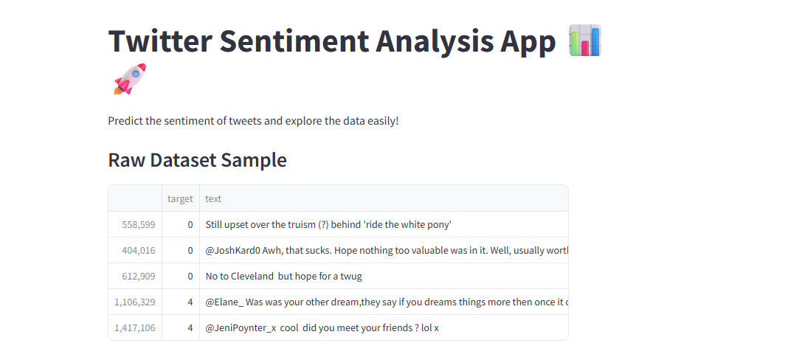

Slide 22
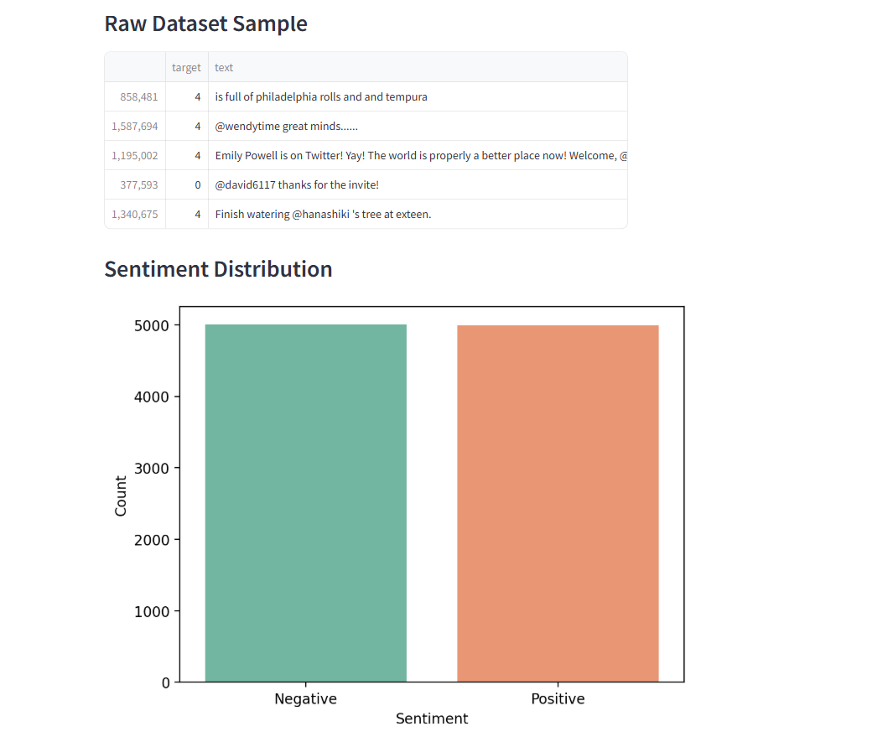

Slide 23
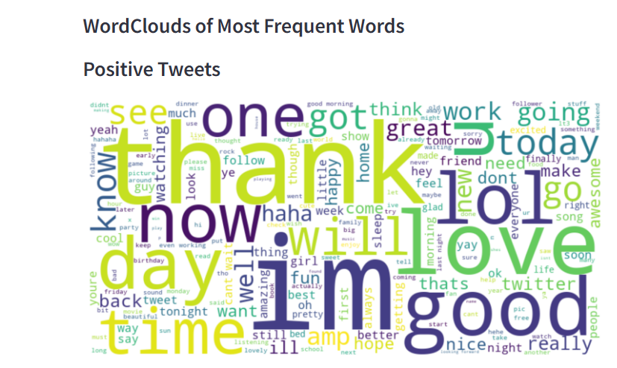

Slide 24
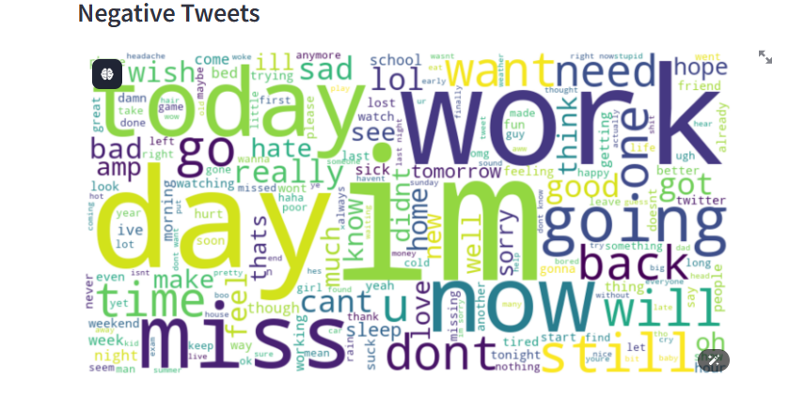

Slide 25
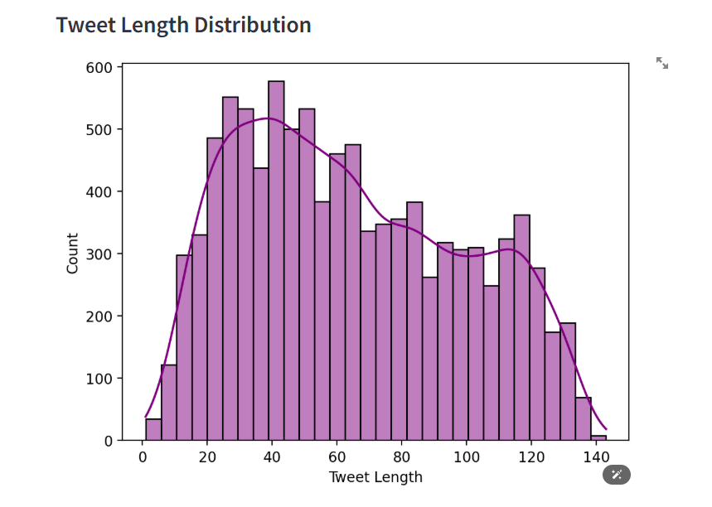

Slide 26
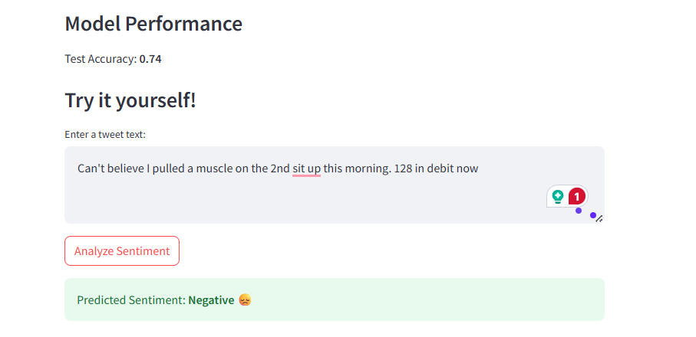

Slide 27

  R

Slide 28
R-Read the Dataset
# 3. Read the dataset (adjust the path to your CSV)
# Columns: sentiment, id, date, query, user, text
df <- read_csv("C:/Users/abdul/Downloads/training.1600000.processed.noemoticon.csv",
col_names = c("sentiment", "id", "date", "query", "user", "text"))
Explanation: Reads a CSV file into a tibble (data frame) with defined column names.

Slide 29
R-Preprocess sentiment
4. Preprocess sentiment: 0 = negative, 4 = positive
df <- df %>%
mutate(sentiment = factor(if_else(sentiment == 4, "pos", "neg")))
Explanation: Transforms sentiment values from numeric to categorical labels ('pos', 'neg')

Slide 30
R- taking a sample
# 5. Sample
set.seed(42)
df_sub <- df %>% sample_n(100000)
Explanation: Takes a random sample of n rows from the dataset.

Slide 31
R- Cleaning text
# 6. Clean text
df_sub <- df_sub %>%
mutate(text = str_replace_all(text, "http\\S+|www\\S+", "")) %>% # Remove URLs
mutate(text = str_replace_all(text, "[^a-zA-Z\\s]", " ")) %>% # Remove punctuation, numbers
mutate(text = str_to_lower(text))
Explanation: for cleaning text form the URLs and punctuation

Slide 32
R- Tokenize &TF-IDF
#7. Tokenize & TF-IDF
tidy_df <- df_sub %>%
select(id, sentiment, text) %>%
unnest_tokens(word, text) %>%
anti_join(get_stopwords()) %>%
filter(str_detect(word, "^[a-z]{2,}$")) %>% # Keep only valid words
count(id, sentiment, word, sort = TRUE) %>%
ungroup() %>%
bind_tf_idf(word, id, n)
Explanation:Tokenizes text into individual words,removes common English stop words from the tokenized words&Counts the frequency of each word per document/sentiment group.

Slide 33
R- Separating and getting the top words
# Separate sentiment word data
pos_words <- tidy_df %>% filter(sentiment == "pos")
neg_words <- tidy_df %>% filter(sentiment == "neg")
# Top words
top_pos <- pos_words %>% count(word, wt = tf_idf, sort = TRUE) %>% head(100)
top_neg <- neg_words %>% count(word, wt = tf_idf, sort = TRUE) %>% head(100)

Slide 34
R- classifying for bar plot
# Top TF-IDF words for bar plot
top_words <- tidy_df %>%
count(sentiment, word, wt = tf_idf, sort = TRUE) %>%
group_by(sentiment) %>%
top_n(10, n) %>%
ungroup()
Explanation: Classiying the top -ve and +ve words for the bar plot visiualization

Slide 35
R- bar plot
# Save bar plot as ggplot object
bar_plot <- ggplot(top_words, aes(x = fct_reorder(word, n), y = n, fill = sentiment)) +
geom_col(show.legend = FALSE) +
facet_wrap(~sentiment, scales = "free") +
coord_flip() +
labs(title = "Top TF-IDF Words by Sentiment", x = NULL, y = "TF-IDF Weighted Frequency") +
scale_fill_manual(values = c("pos" = "#1DA1F2", "neg" = "red"))
Explanation: bar plot to visiualize the most frequent words

Slide 36
R- train test split
# 10. Split
set.seed(123)
train_idx <- createDataPartition(y, p = 0.8, list = FALSE)
x_train <- dtm[train_idx, ]
y_train <- y[train_idx]
x_test <- dtm[-train_idx, ]
y_test <- y[-train_idx]
Explanation :splitting the data into 80% for training and 20% for testing

Slide 37
R- train logistic regression model
# 11. Train logistic regression
cvfit <- cv.glmnet(x_train, y_train, family = "binomial", type.measure = "class")
best_lambda <- cvfit$lambda.min
Explanation: Trains a logistic regression model using cross-validation to choose the best regularization.

Slide 38
R- train logistic regression model
# 11. Train logistic regression
cvfit <- cv.glmnet(x_train, y_train, family = "binomial", type.measure = "class")
best_lambda <- cvfit$lambda.min
Explanation: Trains a logistic regression model using cross-validation to choose the best regularization.

Slide 39
R- Accuracy score for the model
# 13. Accuracy
acc_train <- mean(pred_train == y_train)
acc_test <- mean(pred_test == y_test)
Explanation:for calculating the accuracy for the trained and tested data

Slide 40
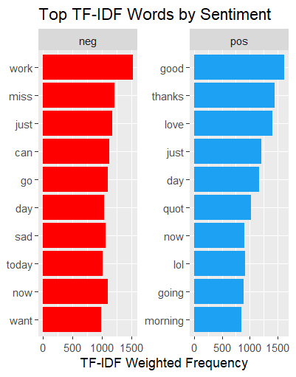

Slide 41
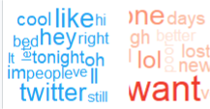

Slide 42

  WEKA

Slide 43
WEKA-Steps
Here’s The Steps:
once you turn your data from categorical to numerical
1.load data set :from explorer tab->open file ->choose Your csv File
2.To make the logistic regression :From classifiy tab->classifiers-->functions->Logistic

Slide 44


RESOURCE PAGE 1 (PYTHON)
Dataset Resource:
https://www.kaggle.com/datasets/kazanova/sentiment140
Code :
1.Machine Learning with python
2.Streamlit for data science

Slide 45

RESOURCE PAGE 2 (R)
1.Machine Learning with R

Slide 46
RESOURCE PAGE 3 (WEKA)
1.WEKA Documentation

Slide 47

THANK
YOU!

